Slide 1
Lecture 20
Interconnectedness, self-regulation and Mutual Fulfilment
among the Four Orders of Nature

Slide 2
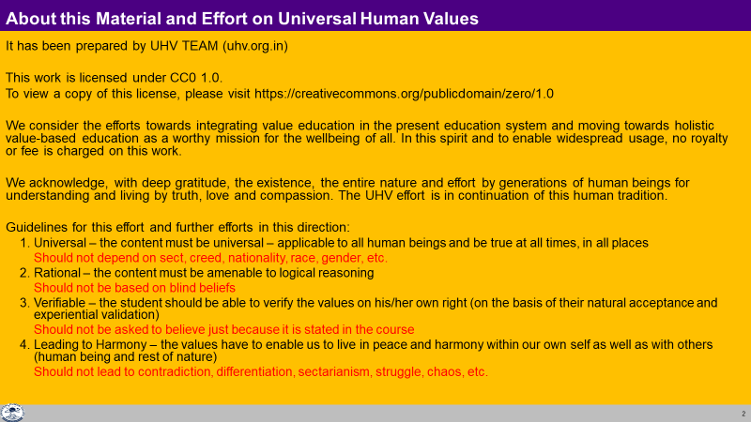

Slide 3
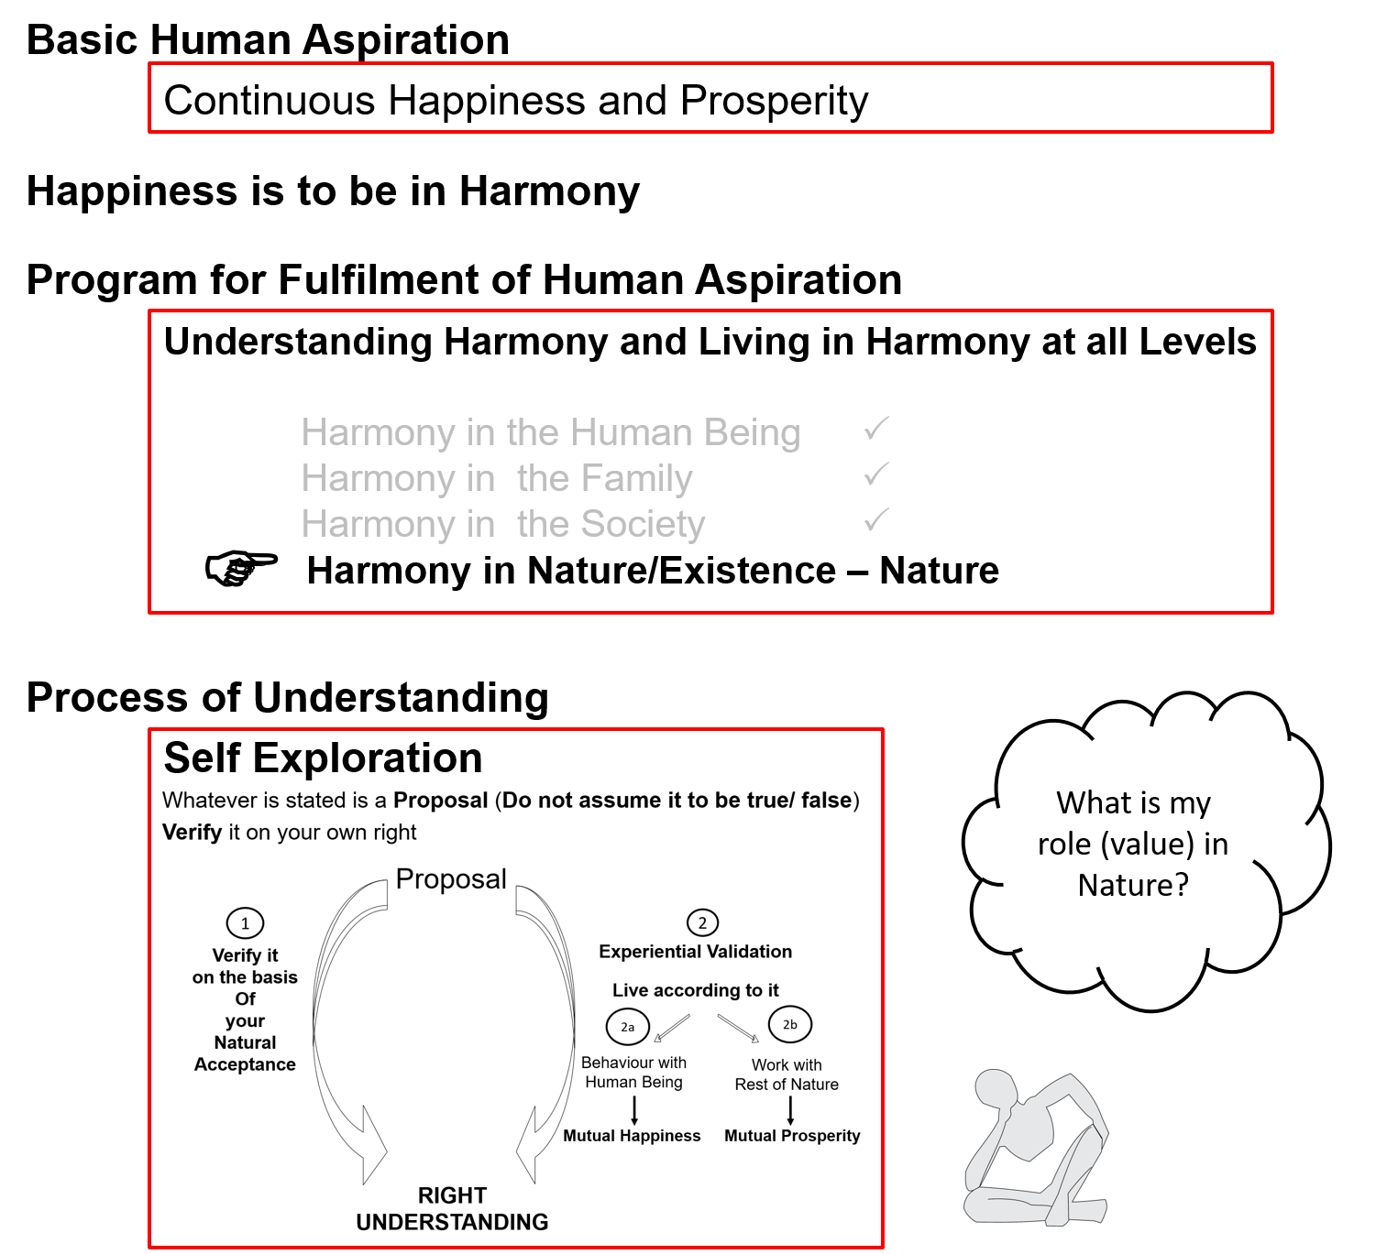

Slide 4
Details of the Four Orders in Nature
ORDERS 4 voLFkk | UNITS bdkbZ | ACTIVITY fØz;k | NATURAL CHARACTERISTIC LoHkko] O;oLFkk esa Hkkxhnkjh (Participation in larger order) | INNATENESS /kkj.kk] /keZ Lo;a esa O;oLFkk (Self-organisation) | INHERITANCE vuq’kaxh;rk
Physical inkFkZ | Soil, Metal feV~Vh] /kkrq | Formation-Deformation jpuk&fojpuk | Composition-Decomposition LakxBu&fo?kVu | Existence vfLrRo | Constitution based Ikfj.kke vuq’kaxh
Bio izk.k | Plants, Trees isM+] ikS/ks | "-“ + Respiration “olu&iz”olu | " + Nurture-Worsen lkjd&ekjd | " + Growth iqf’V | Seed based cht vuq’kaxh
Animal tho | Animals, Birds i”kq] i{kh | "-“, " in Body “kjhj esa Selecting-Tasting in I p;u@vkLoknu eSa esa | ", " in body “kjhj esa Cruelty, Non-cruelty in I eSa esa Øwjrk] vØwjrk | ", " in Body “kjhj esa Will to live in I eSa esa Tkhus dh vk”kk | Breed based oa”k vuq’kaxh
Human Kku | Human Beings euq’; | "-“, " in Body “kjhj esa Imaging, Analysing-Comparing, Selecting-Tasting in I fp=.k] fo'ys’k.k] p;u@vkLoknu eSa esa Natural Acceptance, Potential for Understanding… in I le>us dh {kerk eSa esa | ", " in body “kjhj esa Perseverance, Bravery, Generosity… in I eSa esa /khjrk] ohjrk] mnkjrk | ", " in Body “kjhj esa Will to live with continuous happiness in I eSa esa fujarj Lkq[kiwoZd Tkhus dh vk”kk Right Feeling & Thought lek/kku Right Understanding Kku | Education-Sanskar based f”k{kk&laLdkj vuq’kaxh
Every Order has a definite activity

Slide 5
Details of the Four Orders in Nature
ORDERS 4 voLFkk | UNITS bdkbZ | ACTIVITY fØz;k | NATURAL CHARACTERISTIC LoHkko] O;oLFkk esa Hkkxhnkjh (Participation in larger order) | INNATENESS /kkj.kk] /keZ Lo;a esa O;oLFkk (Self-organisation) | INHERITANCE vuq’kaxh;rk
Physical inkFkZ | Soil, Metal feV~Vh] /kkrq | Formation-Deformation jpuk&fojpuk | Composition-Decomposition LakxBu&fo?kVu | Existence vfLrRo | Constitution based Ikfj.kke vuq’kaxh
Bio izk.k | Plants, Trees isM+] ikS/ks | "-“ + Respiration “olu&iz”olu | " + Nurture-Worsen lkjd&ekjd | " + Growth iqf’V | Seed based cht vuq’kaxh
Animal tho | Animals, Birds i”kq] i{kh | "-“, " in Body “kjhj esa Selecting-Tasting in I p;u@vkLoknu eSa esa | ", " in body “kjhj esa Cruelty, Non-cruelty in I eSa esa Øwjrk] vØwjrk | ", " in Body “kjhj esa Will to live in I eSa esa Tkhus dh vk”kk | Breed based oa”k vuq’kaxh
Human Kku | Human Beings euq’; | "-“, " in Body “kjhj esa Imaging, Analysing-Comparing, Selecting-Tasting in I fp=.k] fo'ys’k.k] p;u@vkLoknu eSa esa Natural Acceptance, Potential for Understanding… in I le>us dh {kerk eSa esa | ", " in body “kjhj esa Potential for Perseverance, Bravery, Generosity… in I eSa esa /khjrk] ohjrk] mnkjrk | ", " in Body “kjhj esa Will to live with continuous happiness in I eSa esa fujarj Lkq[kiwoZd Tkhus dh vk”kk Right Feeling & Thought lek/kku Right Understanding Kku | Education-Sanskar based f”k{kk&laLdkj vuq’kaxh
Every Order has a definite natural characteristic or participation in the larger order
(except for human being without right understanding)
Human Being has to understand to live in accordance with their natural characteristic

Slide 6
Natural Characteristic LoHkko Tendency
Natural Characteristic of Human Living with Human Consciousness
Perseverence (/khjrk) Being assured that the all-encompassing solution is to understand & to live in harmony at all 4 levels, I live with this commitment without any perturbation
Bravery (ohjrk) The commitment to help the other develop right understanding & to live accordingly
Generosity (mnkjrk) Readiness to invest oneself, one's body & physical facility to help the other develop right understanding & to live accordingly
Tendency of Human Living with Animal Consciousness
Wretchedness (nhurk)The feeling I can not take care of my body, hence I resort to being dependent on the other
Cunningness (ghurk) The feeling I can not take care of my body, hence I resort to beguiling the other
Cruelty (Øwjrk) The feeling I can not take care of my body, hence I resort to force and violence

Slide 7
Details of the Four Orders in Nature
ORDERS 4 voLFkk | UNITS bdkbZ | ACTIVITY fØz;k | NATURAL CHARACTERISTIC LoHkko] O;oLFkk esa Hkkxhnkjh (Participation in larger order) | INNATENESS /kkj.kk Lo;a esa O;oLFkk (Self-organisation) | INHERITANCE vuq’kaxh;rk
Physical inkFkZ | Soil, Metal feV~Vh] /kkrq | Formation-Deformation jpuk&fojpuk | Composition-Decomposition LakxBu&fo?kVu | Existence vfLrRo | Constitution based Ikfj.kke vuq’kaxh
Bio izk.k | Plants, Trees isM+] ikS/ks | "-“ + Respiration “olu&iz”olu | " + Nurture-Worsen lkjd&ekjd | " + Growth iqf’V | Seed based cht vuq’kaxh
Animal tho | Animals, Birds i”kq] i{kh | "-“, " in Body “kjhj esa Selecting-Tasting in I p;u@vkLoknu eSa esa | ", " in body “kjhj esa Cruelty, Non-cruelty in I eSa esa Øwjrk] vØwjrk | ", " in Body “kjhj esa Will to live in I eSa esa Tkhus dh vk”kk | Breed based oa”k vuq’kaxh
Human Kku | Human Beings euq’; | "-“, " in Body “kjhj esa Imaging, Analysing-Comparing, Selecting-Tasting in I fp=.k] fo'ys’k.k] p;u@vkLoknu eSa esa Natural Acceptance, Potential for Understanding… in I le>us dh {kerk eSa esa | ", " in body “kjhj esa Potential for Perseverance, Bravery, Generosity… in I eSa esa /khjrk] ohjrk] mnkjrk | ", " in Body “kjhj esa Will to live with continuous happiness in I eSa esa fujarj Lkq[kiwoZd Tkhus dh vk”kk Right Feeling & Thought lek/kku Right Understanding Kku | Education-Sanskar based f”k{kk&laLdkj vuq’kaxh
Innateness: Self Organisation; being in a definite order
Exists, is a reality.
Exists in a definite order.
Every unit is naturally self-organized, except for human being without right understanding
Human being has to understand to be self-organized, i.e., to have right understanding, right feeling and right thought

Slide 8
Details of the Four Orders in Nature
ORDERS 4 voLFkk | UNITS bdkbZ | ACTIVITY fØz;k | NATURAL CHARACTERISTIC LoHkko] O;oLFkk esa Hkkxhnkjh (Participation in larger order) | INNATENESS /kkj.kk Lo;a esa O;oLFkk (Self-organisation) | INHERITANCE vuq’kaxh;rk
Physical inkFkZ | Soil, Metal feV~Vh] /kkrq | Formation-Deformation jpuk&fojpuk | Composition-Decomposition LakxBu&fo?kVu | Existence vfLrRo | Constitution based Ikfj.kke vuq’kaxh
Bio izk.k | Plants, Trees isM+] ikS/ks | "-“ + Respiration “olu&iz”olu | " + Nurture-Worsen lkjd&ekjd | " + Growth iqf’V | Seed based cht vuq’kaxh
Animal tho | Animals, Birds i”kq] i{kh | "-“, " in Body “kjhj esa Selecting-Tasting in I p;u@vkLoknu eSa esa | ", " in body “kjhj esa Cruelty, Non-cruelty in I eSa esa Øwjrk] vØwjrk | ", " in Body “kjhj esa Will to live in I eSa esa Tkhus dh vk”kk | Breed based oa”k vuq’kaxh
Human Kku | Human Beings euq’; | "-“, " in Body “kjhj esa Imaging, Analysing-Comparing, Selecting-Tasting in I fp=.k] fo'ys’k.k] p;u@vkLoknu eSa esa Natural Acceptance, Potential for Understanding… in I le>us dh {kerk eSa esa | ", " in body “kjhj esa Potential for Perseverance, Bravery, Generosity… in I eSa esa /khjrk] ohjrk] mnkjrk | ", " in Body “kjhj esa Will to live with continuous happiness in I eSa esa fujarj Lkq[kiwoZd Tkhus dh vk”kk Right Feeling & Thought lek/kku Right Understanding Kku | Education-Sanskar based f”k{kk&laLdkj vuq’kaxh
Inheritance: How conduct is decided, maintained generation after generation
Every Order has a definite inheritance

Slide 9
Role of Education-Sanskar f'k{kk&laLdkj dh Hkwfedk
ORDERS 4 voLFkk | UNITS bdkbZ | ACTIVITY fØz;k | NATURAL CHARACTERISTIC LoHkko] O;oLFkk esa Hkkxhnkjh (Participation in larger order) | INNATENESS /kkj.kk Lo;a esa O;oLFkk (Self-organisation) | INHERITANCE vuq’kaxh;rk
Physical inkFkZ | Soil, Metal feV~Vh] /kkrq | Formation-Deformation jpuk&fojpuk | Composition-Decomposition LakxBu&fo?kVu | Existence vfLrRo | Constitution based Ikfj.kke vuq’kaxh
Bio izk.k | Plants, Trees isM+] ikS/ks | "-“ + Respiration “olu&iz”olu | " + Nurture-Worsen lkjd&ekjd | " + Growth iqf’V | Seed based cht vuq’kaxh
Animal tho | Animals, Birds i”kq] i{kh | "-“, " in Body “kjhj esa Selecting-Tasting in I p;u@vkLoknu eSa esa | ", " in body “kjhj esa Cruelty, Non-cruelty in I eSa esa Øwjrk] vØwjrk | ", " in Body “kjhj esa Will to live in I eSa esa Tkhus dh vk”kk | Breed based oa”k vuq’kaxh
Human Kku | Human Beings euq’; | "-“, " in Body “kjhj esa Imaging, Analysing-Comparing, Selecting-Tasting in I fp=.k] fo'ys’k.k] p;u@vkLoknu eSa esa Natural Acceptance, Potential for Understanding… in I le>us dh {kerk eSa esa | ", " in body “kjhj esa Potential for Perseverance, Bravery, Generosity… in I eSa esa /khjrk] ohjrk] mnkjrk | ", " in Body “kjhj esa Will to live with continuous happiness in I eSa esa fujarj Lkq[kiwoZd Tkhus dh vk”kk Right Feeling & Thought lek/kku Right Understanding Kku | Education-Sanskar based f”k{kk&laLdkj vuq’kaxh
The conduct of human being is decided by its education-sanskar
Human education-sanskar → Human conduct
Inhuman education-sanskar → Inhuman conduct
Next Generation
Human Education-sanskar

Slide 10
Based on Understanding Nature, Human Being can Decide its Role vis-à-vis each Order
ORDERS 4 voLFkk | UNITS bdkbZ | ACTIVITY fØz;k | NATURAL CHARACTERISTIC LoHkko] O;oLFkk esa Hkkxhnkjh (Participation in larger order) | INNATENESS /kkj.kk Lo;a esa O;oLFkk (Self-organisation) | INHERITANCE vuq’kaxh;rk
Physical inkFkZ | Soil, Metal feV~Vh] /kkrq | Formation-Deformation jpuk&fojpuk | Composition-Decomposition LakxBu&fo?kVu | Existence vfLrRo | Constitution based Ikfj.kke vuq’kaxh
Bio izk.k | Plants, Trees isM+] ikS/ks | "-“ + Respiration “olu&iz”olu | " + Nurture-Worsen lkjd&ekjd | " + Growth iqf’V | Seed based cht vuq’kaxh
Animal tho | Animals, Birds i”kq] i{kh | "-“, " in Body “kjhj esa Selecting-Tasting in I p;u@vkLoknu eSa esa | ", " in body “kjhj esa Cruelty, Non-cruelty in I eSa esa Øwjrk] vØwjrk | ", " in Body “kjhj esa Will to live in I eSa esa Tkhus dh vk”kk | Breed based oa”k vuq’kaxh
Human Kku | Human Beings euq’; | "-“, " in Body “kjhj esa Imaging, Analysing-Comparing, Selecting-Tasting in I fp=.k] fo'ys’k.k] p;u@vkLoknu eSa esa Natural Acceptance, Potential for Understanding… in I le>us dh {kerk eSa esa | ", " in body “kjhj esa Potential for Perseverance, Bravery, Generosity… in I eSa esa /khjrk] ohjrk] mnkjrk | ", " in Body “kjhj esa Will to live with continuous happiness in I eSa esa fujarj Lkq[kiwoZd Tkhus dh vk”kk Right Feeling & Thought lek/kku Right Understanding Kku | Education-Sanskar based f”k{kk&laLdkj vuq’kaxh
Notes:
Activity – taking place during the interaction with the other unit, क्रिया →
Natural Characteristic – Interaction with other units, स्वभाव →
Innateness – Self-organization, धारणा

Slide 11
Participation of Human Being in Entire Nature
Preservation (enrichment, protection and right utilization) of nature
and
Prosperity, fulfilment of human needs (in a manner that preserves nature)
i.e. by:
  Protecting its innateness
  Protecting and enriching its inheritance
  Making right utilization of nature, in line with its activity
  (or at least not violating their innateness, inheritance or activity)

Slide 12
Participation of Human Being in Entire Nature
Physical order: Soil, water, air…
Protect its innateness (existence)
(eg. Protect constitution of Earth)
Bio order: Plants, trees…
Protect and nurture its innateness (existence and growth)
(eg. Ploughing farmland)
Ensure its inheritance (seed)
(eg. Maintain seed of rice)
Animal order: Animals and birds
Protect its innateness (will to live)
(eg. Adequate forest, food, shelter)
Ensure its inheritance (breed)
(eg. Maintain breed of cow)
Human order: Human being
Protect its innateness (will to live with continuous happiness)
(eg. Provide societal systems for facilitating and living with right understanding)
Ensure its inheritance (education-sanskar)
(eg. Ensure human education-sanskar)

Slide 13
Participation of Human Being in Entire Nature
To understand the inherent harmony in nature and to live accordingly, i.e.
  To facilitate a conducive environment for the activity (at least not violate it) of all orders
  To facilitate the innateness (or at least not violate it) of all orders
  To facilitate the inheritance (or at least not violate it) of all orders
Order | Human Participation for Mutual Fulfillment
Physical Order | Facilitate its existence by ensuring conducive environment and maintaining / ensuring its constitution (eg. constitution of earth)
Bio Order | Facilitate its growth by ensuring conducive environment and maintaining / ensuring its seed (e.g. seed of rice)
Animal Order | Facilitate care of the body by ensuring physical facility, environment for existence & growth of body. To ensure its will to live Maintaining / ensuring its breed (eg. breed of cow)
Human Order | Facilitate care of the body by ensuring physical facility, environment for existence & growth of body Facilitate its will to live with continuous happiness by ensuring human education-sanskar, participating in developing / maintaining undivided society & universal human order

Slide 14
Sum Up
Physical order – soil, metals etc.
Bio order – trees, plants etc.
Animal order – animals, birds etc.
Human order – human beings
There is a relationship of mutual fulfilment (harmony) amongst these 4 orders. The first 3 orders are mutually fulfilling for each other. They are fulfilling for human being also. It is naturally acceptable to human beings to be fulfilling for all the orders
The role of human being is to realize this mutual fulfilment – For this, all that human beings need to do is:
  To understand that mutual fulfilment (harmony) is inherent in nature – we do not have to create it
  To live accordingly – then the mutual fulfilment amongst the 4 orders will be realised
and there is provision in nature for living with mutual fulfilment (harmony)
Nature = Collection of Units
= 4 Orders
Relationship of mutual fulfilment (harmony)

Slide 15
Self Reflection

Slide 16
Self Reflection
What are your assumptions about nature? Is it for human enjoyment or does human being have a role to play for harmony in nature?
In a typical day, how much time do you interact with physical order, bio order, animal order and human order? What is that interaction (taking, giving, appreciating, fulfilling a responsibility…)
How do you and your family contribute to / participate in maintaining the order (harmony) in nature?
Can you see that units of the physical order, bio order and animal order have a definite conduct? Can you see that if the conduct of a human being is in accordance with their natural acceptance, then it will be definite (because the natural acceptance is definite)?

Slide 17
Key Points
Lecture 20: Interconnectedness, self-regulation and Mutual Fulfilment among the Four Orders of Nature

Slide 19
Details of the Four Orders
ORDERS 4 voLFkk | UNITS bdkbZ | ACTIVITY fØz;k | INNATENESS /kkj.kk (Self-organisation) | INHERITANCE vuq’kaxh;rk
Physical inkFkZ | Soil, Metal feV~Vh] /kkrq | Formation-Deformation jpuk&fojpuk | Existence vfLrRo | Constitution based Ikfj.kke vuq’kaxh
Bio izk.k | Plants, Trees isM+] ikS/ks | "-“ + Respiration “olu&iz”olu | " + Growth iqf’V | Seed based cht vuq’kaxh
Animal tho | Animals, Birds i”kq] i{kh | "-“, " in Body “kjhj esa Selecting-Tasting in I p;u@vkLoknu eSa esa | ", " in Body “kjhj esa Will to live in I eSa esa Tkhus dh vk”kk | Breed based oa”k vuq’kaxh
Human Kku | Human Beings euq’; | "-“, " in Body “kjhj esa Imaging, Analysing-Comparing, Selecting-Tasting in I fp=.k] fo'ys’k.k] p;u-vkLoknu eSa esa Potential for Understanding in I le>us dh {kerk eSa esa | ", " in Body “kjhj esa Will to live with continuous happiness in I eSa esa fujarj Lkq[kiwoZd Tkhus dh vk”kk Right Feeling lek/kku Right Understanding Kku | Education-Sanskar based f”k{kk&laLdkj vuq’kaxh
Lo;a esa O;oLFkk
Next Generation
Human Education-sanskar

Slide 20
Sum Up
Physical order – soil, metals etc.
Bio order – trees, plants etc.
Animal order – animals, birds etc.
Human order – human beings
There is a relationship of mutual fulfilment (harmony) amongst these 4 orders. The first 3 orders are mutually fulfilling for each other. They are fulfilling for human being also. It is naturally acceptable to human beings to be fulfilling for all the orders
The role of human being is to realize this mutual fulfilment – For this, all that human beings need to do is:
  To understand that mutual fulfilment (harmony) is inherent in nature – we do not have to create it
  To live accordingly – then the mutual fulfilment amongst the 4 orders will be realised
and there is provision in nature for living with mutual fulfilment (harmony)
Nature = Collection of Units
= 4 Orders
Relationship of mutual fulfilment (harmony)

Slide 21
FAQs for Lecture 20
Interconnectedness, self-regulation and Mutual Fulfilment among the Four Orders of Nature

Slide 22
Question(s): Classification Response
How do we know whether a Self is associated with a unit or not?

Slide 23
Nature = Collection of Units = 4 Orders
The presence of Self (I) is
indicated by
1. the presence
of the activity of Assuming
2. Developed part of the Body that can communicate with the Self – Brain
3. Can take signals from HB
To understand the other three orders, right understanding of the Human Order is required,
otherwise over-evaluation, under-evaluation or otherwise-evaluation of the other orders keeps taking place.
Recognizing, Fulfilling
Bio Order
Plants, Trees
izk.k voLFkk
isM+] ikS/ks
Assuming,
Recognizing, Fulfilling
Recognizing, Fulfilling
Physical Order
Soil, Metal
inkFkZ voLFkk
feV~Vh] /kkrq
Animal Order
Animals, Birds
tho voLFkk
i”kq+] i{kh
Self (I) +
Body
Human Order
Human Being
Kku voLFkk
euq’;
Assuming,
Recognizing, Fulfilling
Potential for Knowing, Assuming,
Recognizing, Fulfilling
Self (I) + Body

Slide 24
Question(s): Classification Response
Why are the units in Nature divided into these 4 categories? What is the purpose of this classification?
There are countless units in the nature.
To understand the nature, we need to classify into some countable categories. Here they have been classified into four categories.
The classification into four orders is based on the common innateness, natural characteristics, activities and inheritance in each of the orders.

Slide 25
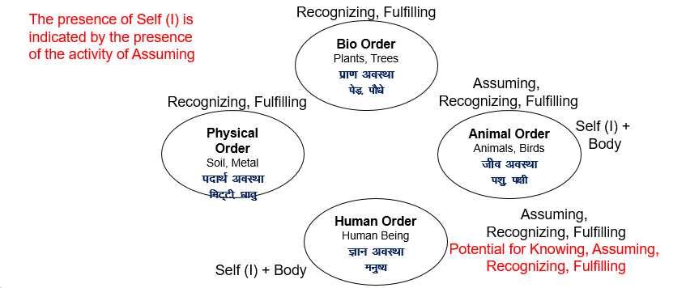
Question(s): Classification Response
For a given unit, how do I make out to which order it belongs to? E.g. fish, insects…
We need to study the activities, innateness, natural characteristics of the unit.
Broadly,

Slide 26
Question(s): Classification Response
It is said that every living as well as non-living thing has consciousness. Please comment
We need to understand the word ‘living’ and ‘non-living’. We need to make out whether we are associating life to
Recognizing and fulfilment, or
Assuming, … or
Knowing,..
Many a times, activity of recognizing and fulfilling with some sophistication like in plants is also termed as living.
The presence of self is marked by the activity of assuming. Recognizing and fulfilment can take place in material units too. Self is consciousness.

Slide 27
Question(s): Harmony in the Nature Response
When there is natural calamity like an earthquake or landslide or huge storm, it creates so much destruction. How can we say that there is harmony in nature?
In the nature, physio-chemical activities are taking place in the material units based on definite recognition and fulfilment. And every activity is participating in a larger order.
e.g. dying of human and animal bodies, dying of plants and trees, in the bio-order
Similarly, there are changes in the physical order like earthquake, landslide, storms, volcano eruption etc.
Looking at these activities, there may appear disharmony. But looking at the organization of the units in a holistic sense, there is harmony.
Another thing to understand is that whatever changes that take place in the rest of the nature are only physio-chemical. There is no unhappiness involved there. There is unhappiness only when the Self is in disharmony or participating in disharmony.

Slide 28
Question(s): Harmony in the Nature Response
Similarly
A similar response as earlier.
As the theory goes, human beings came up after the dinosaurs vanished.

Slide 29
Question(s): Harmony in the Nature Response
The JC Bose experiment clearly showed plants could feel pleasure and they could feel pain. So, is there a Self associated with plants?
The JC Bose experiment showed the fulfilment (response) in the plants based on recognition to certain activities (stimuli). But that is again in the domain in recognition and fulfilment. We assign words like pleasure or pain to such responses. There is no Self involved here.
A similar thing can be observed in our bodies.

Slide 30
Question(s): Harmony in the Nature Response
Dr Imoto did some amazing experiments with water. They showed that there is an impact of feelings on water and water has memory. What is your comment on it?
Property of a unit is effect of one unit on the other. This effect can be lasting for a long time. Sometimes, it is termed as memory.
The word ‘memory’ has been used in multiple ways. Memory has been placed in the consciousness as well as material in the literature. We need to make out the precise meaning of memory that we are talking about.

Slide 31
Question(s): Mutual Fulfilment Response
There is struggle for survival and survival of the fittest in nature. Why are we saying that there is mutual fulfilment in nature?
First of all, we need to understand the word survival. Are we talking about the conscious units or material units?
For the self, it anyway continues. And all the material units are active in a cyclic manner. So, when we use the word ‘survival’, we need to be clear about the entities that we are considering.
Feeling of struggle is there in the Self which anyway continues. In the rest of the nature, there are only physio-chemical activities where there is no feeling.
In the bio-order there is natural characteristic of enhancing and worsening. Many a times, this has been seen as struggle, and hence survival of the fittest.

Slide 32
Question(s): Mutual Fulfilment Response
In nature the first three orders are already having definite conduct. Why does human order have to work for definite conduct? I mean why is that also not automatic or natural?
In the nature, the units of the first two orders do not have self associated with them. Hence, there is only recognition and fulfillment in their response which is definite.
In the animal order, self is co-existing with the body. But there is no potential in the self to know, there is only activity of assuming. And living is largely governed by the body. Hence, the conduct is definite.
In the human order, there is potential to know. And there is will to live with happiness in continuity which is fulfilled by right understanding, right feeling. Since, it is not ensured, we have to work for it. And once it is ensured, we can be much more fulfilling for the nature.

Slide 33
Question(s): Mutual Fulfilment Response
Is solely education responsible for the conduct? Are there any other factors?
If we limit education to the formal education, then it is not solely responsible. But if we equate education to the process of right understanding in the self, then it is solely responsible. If this process is enabled, it will lead to definite conduct.
If we look at other factors, then we have to look at all the factors that facilitate the process of right understanding. But there again, it will be the process being enabled for all human beings around an individual.

Slide 34
Question(s): Mutual Fulfilment Response
Are the problems like global warming a result of human activities only?
Global warming can be owing to several factors. But if we are contributing to this problem, we are not participating in the harmony in the nature. And that becomes indefinite conduct.

Slide 35
Question(s): Mutual Fulfilment Response
There are some herbivorous animals and some carnivorous animals. This is in keeping with the harmony in nature. So, if humans also eat animals, what is wrong in it?
The coastal people survive on fish. If eating fish is wrong, then how will they survive?
We consume milk. Isn’t it exploitation of the calf? We are taking its share.
So are activities like bio engineering, GMO inhuman?

Slide 36
Question(s): Inheritance Response
In animals too, the conduct is not the same in the same breed. One cow may be violent while the other may be very gentle. How does it happen?
We are saying that the conduct of a plant is seed based. But the same tree gives a number of seeds. And the trees that grow from these seeds have variety in terms of growth, fruits, taste of fruits, etc. Why does this happen then?
Human being is not breed based. Then why the form of the body, the diseases, the genetic properties are governed by the older generation?

Slide 37
Question(s): Mutual Fulfilment Response
Eating animals contains the population of the animals. So, what is bad in eating animals?
What if we consume animals after they die naturally?
While breathing, we are killing so many micro-organisms. Our very survival is based on exploitation. So, how can we be part of harmony in the nature?
We take the fur of sheep to make woollen clothes. Isn’t it exploitation of sheep?

Slide 38
Question(s): Mutual Fulfilment Response
The population of human beings is increasing . Where are the Selves coming from?
Can the Self of a human also go to an animal?
What if one consumes an animal after it dies?
In which category do viruses lie?
Dinosaurs once lived on the earth and they died. Is it in keeping with harmony in nature?

Slide 39
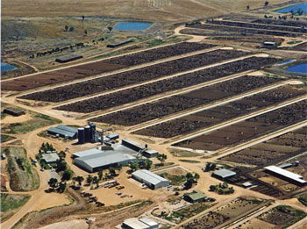
Food for Human Being – Vegetarian, Non Vegetarian, Vegan…
Feeling of Responsibility toward the Body (feeling of self-regulation)
for Nurturing the Body – Naturally Acceptable [Definite, Continuous…]
Food, Choice of Food – Expression of the Feeling [Can have variety, not definite, depends on taste…]
Construction of my Body – Herbivorous, Carnivorous, Omnivorous?
Which order to take food from? Physical, Bio, Animal, Human? Natural Acceptance to take away the Body from any Self?
Sustainable?
20% of all life produced on land every year is harvested for human purposes
14-16 kg grain & 21,000 litres of water → 1 kg meat
The world's cattle alone (not including other livestock) annually consume food grains enough for 8.7 billion people
Land use – 3¼ acres/person on meat diet vs 0.2 acres/person on veg diet
20% Amazon rain forest (the size of California) destroyed since 1970
80% of this land is used for cattle raising
By feeding grain to livestock, we lose 90% of the protein, 96% of the calories, 99% of its carbohydrates, and 100% of the fiber. Animal-based diets are high in saturated fat, excessive protein and cholesterol, leading to heart disease and stroke (nearly 50% of all deaths in the US)
http://www.planetaryrenewal.org/ipr/vegetarian.html

Slide 40
